Slide 1
Time Off in Lieu (TOIL) Policy
October 2023

Slide 2
Time off in lieu (TOIL)
The nature of med comms means there are peaks and troughs of work, and going on site often requires a short period of intense working
Many med comms agencies simply expect their staff to get the job done irrespective of the number of hours that need to be put in
We care about your wellbeing: we don’t want anyone to be working long hours regularly
TOIL is a mechanism that allows us to give people a break to rest and recover after a period where they’ve been working particularly long hours
The priority is to prevent the need for TOIL: by managing workload so that intense periods don’t go on too long, and regularly monitoring timesheets to identify and address workload issues

Slide 3
Accurate recording of time is essential
If your hours aren’t accurately logged then we don’t know how much you’re working, which means we can’t deal with any issues
Over-servicing and under-billing hurt the business in many ways: the profit we make is what pays for salaries, bonuses, and the other Planet- and People-related activities we care so much about – including TOIL
Everyone needs to log time accurately and promptly so we can recharge it to our clients
It’s critical to be precise about the number of hours it has taken to do the work
Client work should never be logged to internal jobs, because then we don’t know the reality of delivering it
You should agree with the project team how to deal with potential overruns and out-of-scope working, and the best way to log on-site time so that we can maximise rechargeability and budget accurately in the future

Slide 4
Our TOIL policy: part 1 – busy periods
The Working and Wellness policy in the Group Policies folder on Sharepoint explains how flexible working can help you and the people you work with to fit work around life
Above all, we’re flexible, but be considerate
While med comms involves peaks and troughs of work, we don’t want anyone to be regularly working more than 1.1 FTEs
Managers will monitor this, and TOIL will be awarded for particularly long hours to allow taking a break when it’s needed
If you are required to work at a weekend or bank holiday, we will give you TOIL for that day – you are effectively swapping a non-working day and a working day

Slide 5
Our TOIL policy: part 2 – on-site working
Events are part of the ‘fun’ of working in med comms, and provide a great opportunity to meet people face-to-face, develop new skills and travel to new places. It also gives you a chance to stay on in your own time, with your travel already paid for
Being on-site at events can involve a few days of long hours due to the nature of the work, so on-site working has to be considered differently
We are often only able to invoice for 8 hours per day for on-site time (per our Master Services Agreement with the client), meaning that TOIL isn’t funded by project budgets
Where possible we will aim to make agreements with clients to allow us to bill much closer to the actual hours spent on site, helping to pay for TOIL
Unlike some med comms agencies, who do not typically award any TOIL for on-site working, we do:
If you are travelling or working on-site on a weekend or bank holiday we will give you those days back as TOIL
For weekday travel and on-site working, we will award time off for days that are particularly long

Slide 6
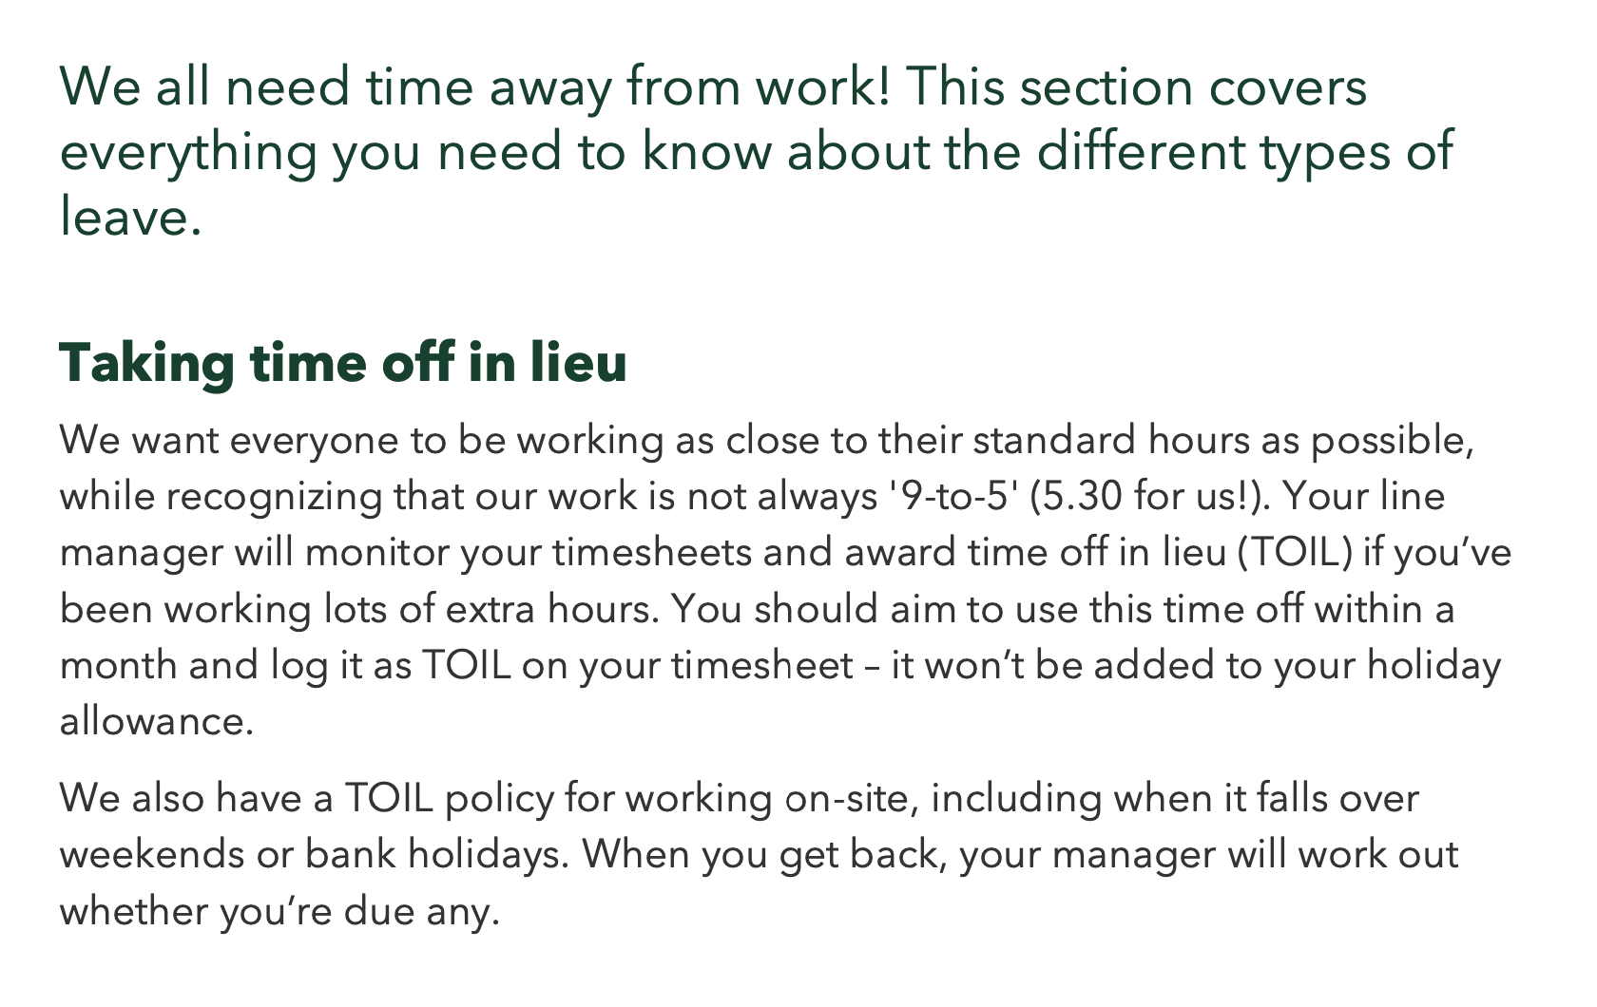
And finally, to note…
The TOIL policy is not part of your contract, and TOIL is awarded at the Company's discretion
The policy may be amended from time to time at the Company's discretion, and any updates will be communicated to you and/or included in the Company Handbook
What the Company Handbook says about TOIL

